Slide 1
Multi-Class Text Classification of Consumer Finance Complaints
- Kaustubh Deodhar

Slide 2
Problem statement:
Create a complaint resolution workflow by classifying consumer finance
complaints into 12 pre-defined classes.
Assumptions:
We can assume each new complaint is assigned to one and only
one category.
Dataset Description:
Given dataset has 18 columns
But for this project we need only two columns product and consumer
complaint narrative.
Product is our target variable and consumer complaint narrative is feature.

Slide 3
Data Cleaning and wrangling:
Remove missing values from consumer complaint narrative
convert categorical column product into integer
Remove stop words eg. a, an, the
Implement steming eg. Playing -> play
Find out ngrams eg. unigrams and bigrams

Slide 4
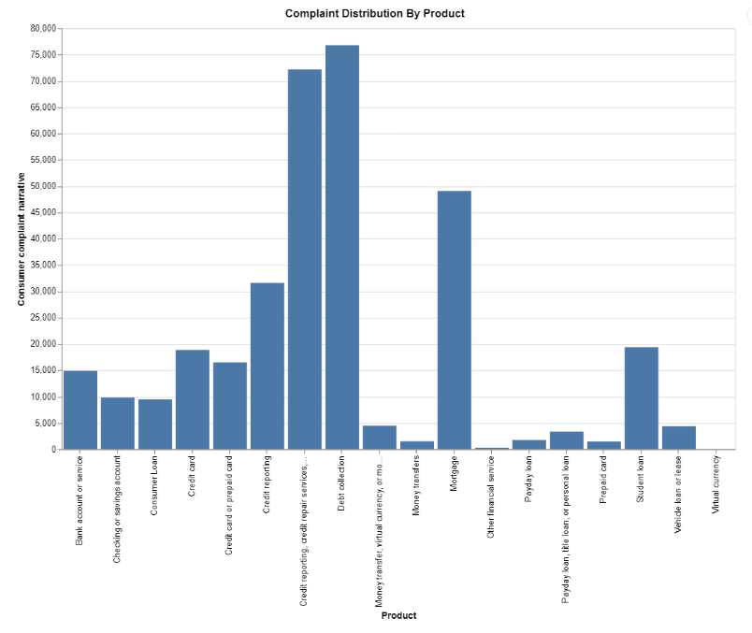
More than 50% of the complaints are related to Mortgage, Credit reporting, credit repair services, or other personal consumer reports, and Debt collection.

Slide 5
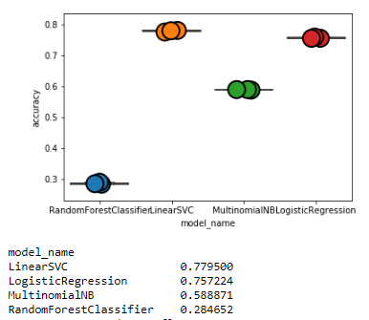
I used TfidfVectorizer to create sparse matrix
Using cross validation with 3 folds I ran RandomForestClassifier, LinearSVC, MultinomialNB (Naive Bayes Classifier) and LogisticRegression.
With 77% accuracy, LinearSVC model performed the best of out all.

Slide 6
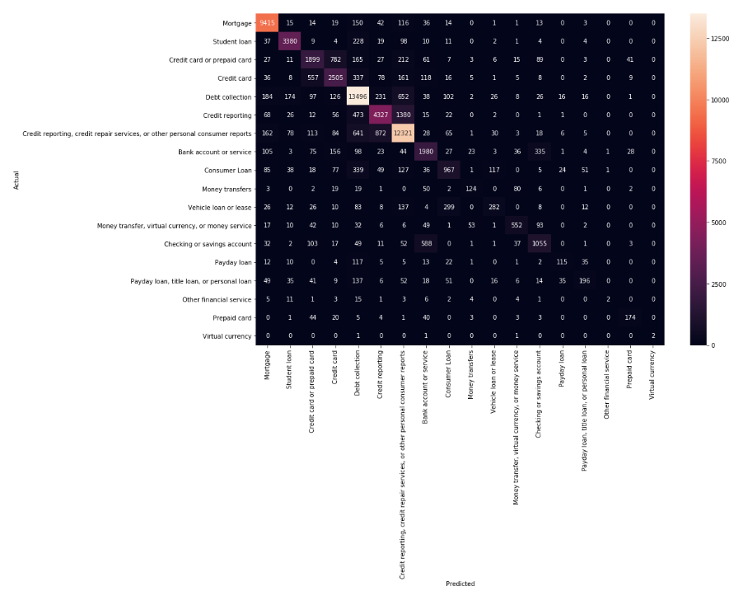
I split the data into Train (80%) and test (20%) to test the model and print
confusion matrix.
As expected most of the predictions are correct. There are few
misclassifications as well. I believe that it because some complaints can be
classified in multiple categories.

Slide 7
Conclusion:
With 77% accuracy we can assign correct product category to a consumer
complaint.
Future Development:
If I have more resources and machine power then I can implement
Gridsearch, steming and multi label classification.

